Slide 1

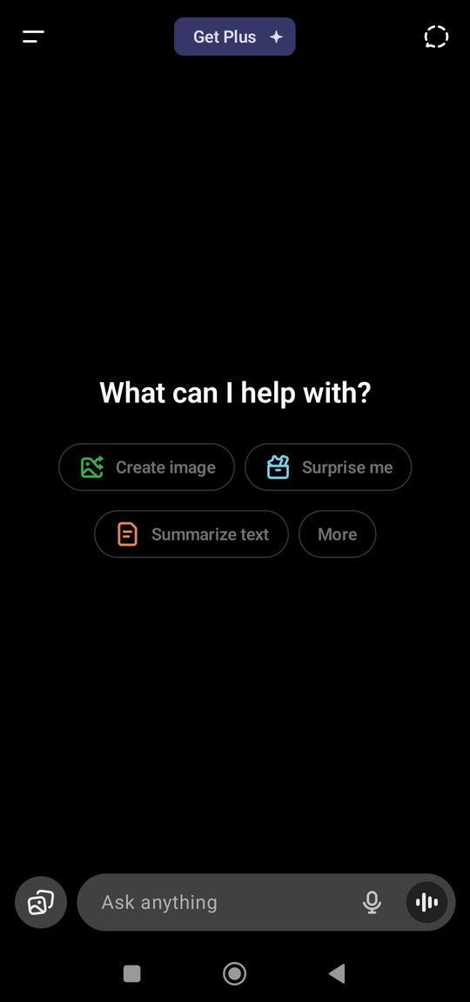




Milestone 2
User Research : why users are not using voice input on ChatGPT mobile
Speak
&
Listen
Batch 39 - Dipak Nandeshwar
next slide

Slide 2






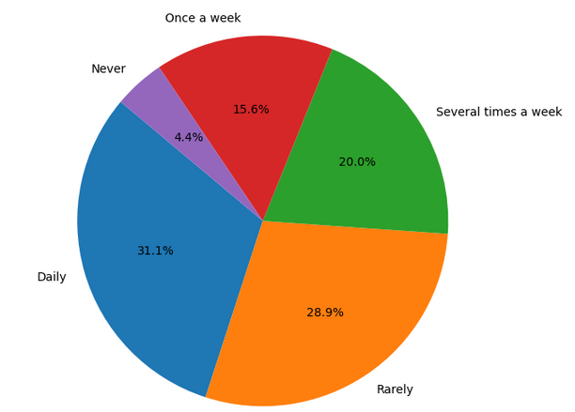

User Segmentation
Professional use cases drive premium conversions
Daily usage patterns create habit formation opportunities
Office productivity applications have clear ROI
Word-of-mouth influence among professional network
Chosen Segment: Regional Language Working Professionals
Why this Segment?
Strategic Impact
Survey data (n=44)
Survey Results: 43.2% have tried voice input, 56.8% have not
Primary Segment: Working Professionals (70.5% of sample)
Age Group: 25 - 40
Key Finding: Barriers are both behavioral and technical, with significant language-specific variations
70.5% of ChatGPT users are working professionals
84% of users prefer regional languages (Hindi/Marathi/Telugu/Tamil)
Combined segment represents 58% of total user base with highest engagement potential
.
High engagement with Tech
Socially active and peer influencer
Openness to new feature
Voice Adoption Potential
Mixed current adoption: Hindi (64.3%) vs Telugu (14.3%)
High improvement likelihood: Average 4.2/5 willingness to use more if improved
Clear value proposition: Productivity enhancement in professional contexts
FREQUENCY OF VOICE INPUT USAGE IN OTHER APPS
HYPOTHESIS
Users believe that ChatGPT’s voice input does not accurately understand Indian regional languages or mixed English-regional speech, leading to errors and frustration.
Working professionals feel self-conscious or awkward using voice input in office or public settings due to social norms and privacy concerns.
A significant portion of users are simply unaware that voice input exists or how to activate it within ChatGPT mobile.
Some users still prefer typing (habit, speed, perceived reliability) over speaking, even when regional language typing is tedious.
Delays, inability to pause/resume, or slow transcription and processing make the current experience frustrating and break user trust.
next slide

Slide 3





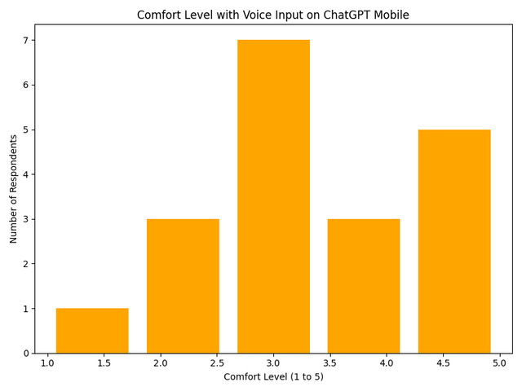
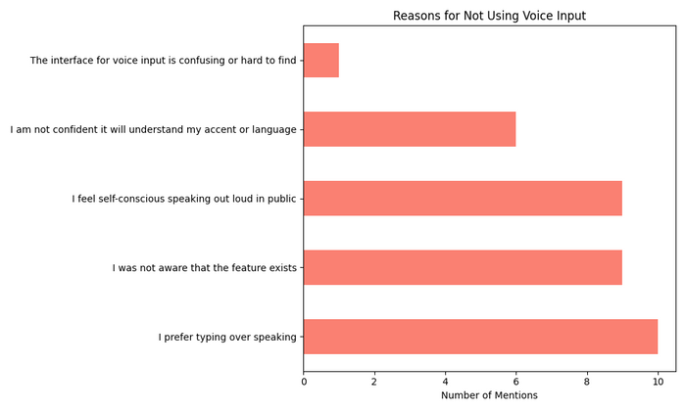
User Research Insights
User Persona
Quantitative Insights
Qualitative Insights
Adoption Barriers (Top 5):
Behavioral Preference (40%): I prefer typing over speaking
Social Anxiety (36%): Feel self-conscious speaking in public
Awareness Gap (32%): Wasn't aware feature exists
Accent Confidence (24%): "Not confident about accent recognition"
UX Issues (4%): Interface confusing/hard to find"
Language-Specific Adoption Rates:
Hindi: 64.3% adoption (highest)
Marathi: 50.0% adoption
Tamil: 25.0% adoption
Telugu: 14.3% adoption (lowest)
Technical Challenges:
Audio doesn't get processed consistently
Poor transcript quality and misinterprets accent
Can't pause and resume - input gets cut off
Slow processing/response time
Mishears local words
Improvement Requests:
Better [regional language] pronunciation recognition
Pause and resume functionality
Real-time transcription
Better noise cancellation
Integration with calendar and email
User Mental Models:
Voice expected to work like Google Assistant (always-on, context-aware)
Expectation of bilingual support (code-switching English-regional)
Professional use cases require accuracy >95% for trust
RAVI KUMAR
ANJALI SHARMA
Age: 30
Occupation: IT Project Manager
Language: Hindi
Voice Usage: Tried but finds accent recognition lacking; awkward using voice input in shared office
Pain Points: Low confidence in Hindi recognition, workplace social anxiety
Needs: Accurate Hindi detection, private voice mode
Goal: Increase productivity, reduce typing fatigue
Age: 28
Occupation: Marketing Specialist
Language: Marathi
Voice Usage: Rarely uses, unaware of feature, unclear activation
Pain Points: Confusing UI, worries about accuracy
Needs: Clear onboarding, UI prompt, improved Marathi recognition
Goal: Quicker content creation, frictionless AI interaction
SURESH PATIL
PRIYA DESHMUKH
Age: 35
Occupation: Finance Analyst
Language: Telugu
Voice Usage: Avoids due to poor accuracy and slow response
Pain Points: Misunderstood Telugu accent, transcription delays
Needs: Fast, accurate Telugu recognition, pause/resume feature
Goal: Automate report generation, minimize manual input
Age: 26
Occupation: Software Developer
Language: Tamil
Voice Usage: Tried but stopped due to lack of Tamil support
Pain Points: Can’t trust voice input for technical/coding queries
Needs: Full Tamil support, better accent handling
Goal: Boost coding productivity, cut down on typing
next slide

Slide 4







Problem Framing Canvas
Problem Statement
Regional language working professionals in India cannot effectively use ChatGPT voice input for productivity workflows because of poor accent recognition, social usage constraints, and limited regional language support, forcing them to use slower text input methods that reduce engagement and prevent natural AI collaboration in professional contexts.
Target User
Success Criteria
Primary: Hindi/Marathi working professionals (25-40 years)
Context: Office and home-based productivity tasks
Current Behavior: Use ChatGPT for email drafts, presentations, problem-solving
Pain Point: Typing complex queries is slow, especially in regional scripts
Primary KPI: Voice input adoption rate among regional working professionals (target: 60% within 6 months)
Quality: Voice recognition accuracy >90% for top 4 regional languages
Engagement: 40% increase in session length when voice is used
Business: 25% higher premium conversion for voice-active users
User Needs (Jobs to be Done)
Functional: Dictate complex professional queries quickly and accurately
Emotional: Feel confident that AI understands their natural speech patterns
Social: Use voice input privately without social awkwardness
Economic: Improve work productivity through faster AI interaction
Root Cause Analysis
Technical Barriers: Insufficient training data for Indian accents and regional languages
UX Barriers: Poor discoverability and context-inappropriate activation patterns
Social Barriers: Public usage anxiety in open office environments
Expectation Mismatch: Users expect Google Assistant-level accuracy and speed
Current Experience
Awareness: 32% unaware of voice feature existence
Trial: 43% have tried, but usage remains sporadic
Satisfaction: Mixed due to accuracy and speed issues
Workaround: Default to text input despite being slower
Hypothesis for Solution
If we improve voice recognition accuracy for Hindi and Marathi accents to >90%, add pause/resume functionality, and create private workspace modes, then regional language working professionals will increase voice input usage by 3x, leading to higher engagement and premium conversions.
next slide

Slide 5
Thank You!
Sources:
https://docs.google.com/spreadsheets/d/1KUNuwnisUSjDZeZ4slgKPNQFW3M4TCD8SDiFcaSJBHA/edit?usp=sharing

